Slide 1
Games Design & Technical Design Document

Slide 2
Game Concept
GDD
The Idea behind my game is to have a 3D-isometric scene and within this will be a Space Marine Dreadnought which has fallen and laying in the surrounding environment. You will be able to rotate the camera by switching between four 90 degree spaced out points around the scene so it will always be isometric. Along side that I intend to have UI with sliders which can change the weather or daylight cycle. You wont be able to play as any character and will purely be just for viewing. The model of the Dreadnought will be created as if it was being put into a game. The focus on this will be my modelling abilities as-well as my scene creation. The intention of this scene is to be a vertical slice of a greater landscape. This will all happen inside UE5 and the models will be made in Blender. I’m not sure if I will add audio however If I do it would most likely be to do with the environment. Such as if you’d change the weather, there could be rain and wind etc.

Slide 3
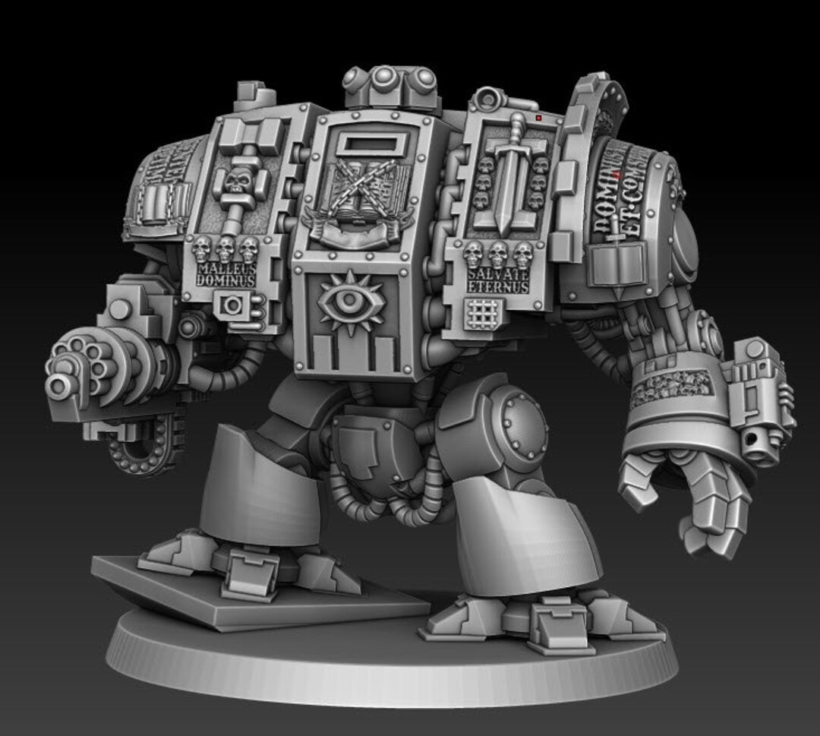
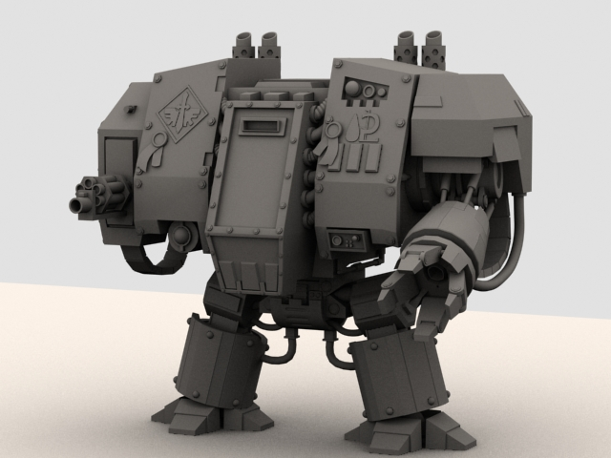
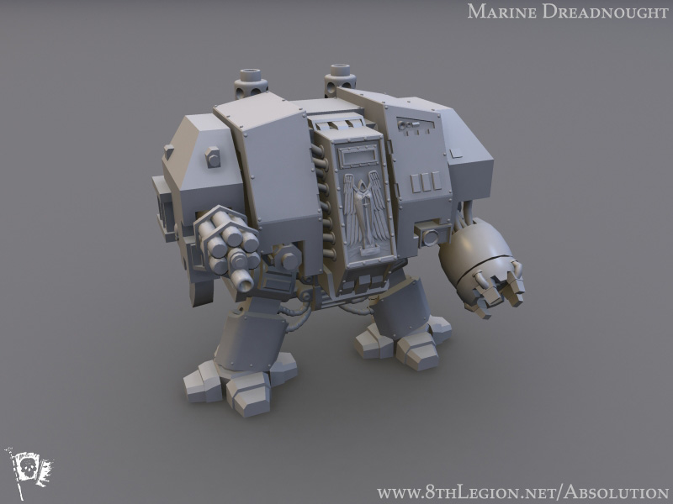
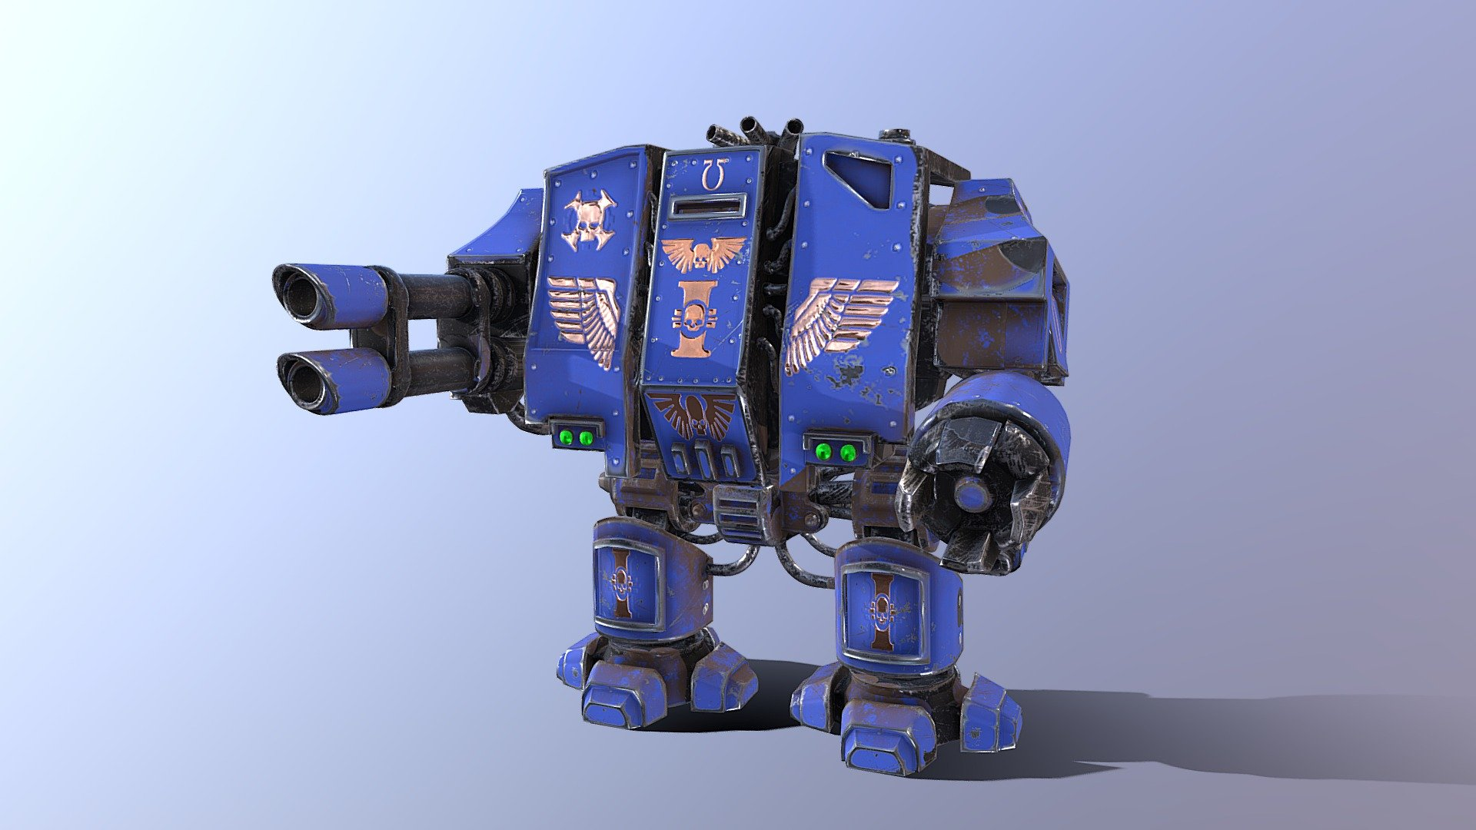
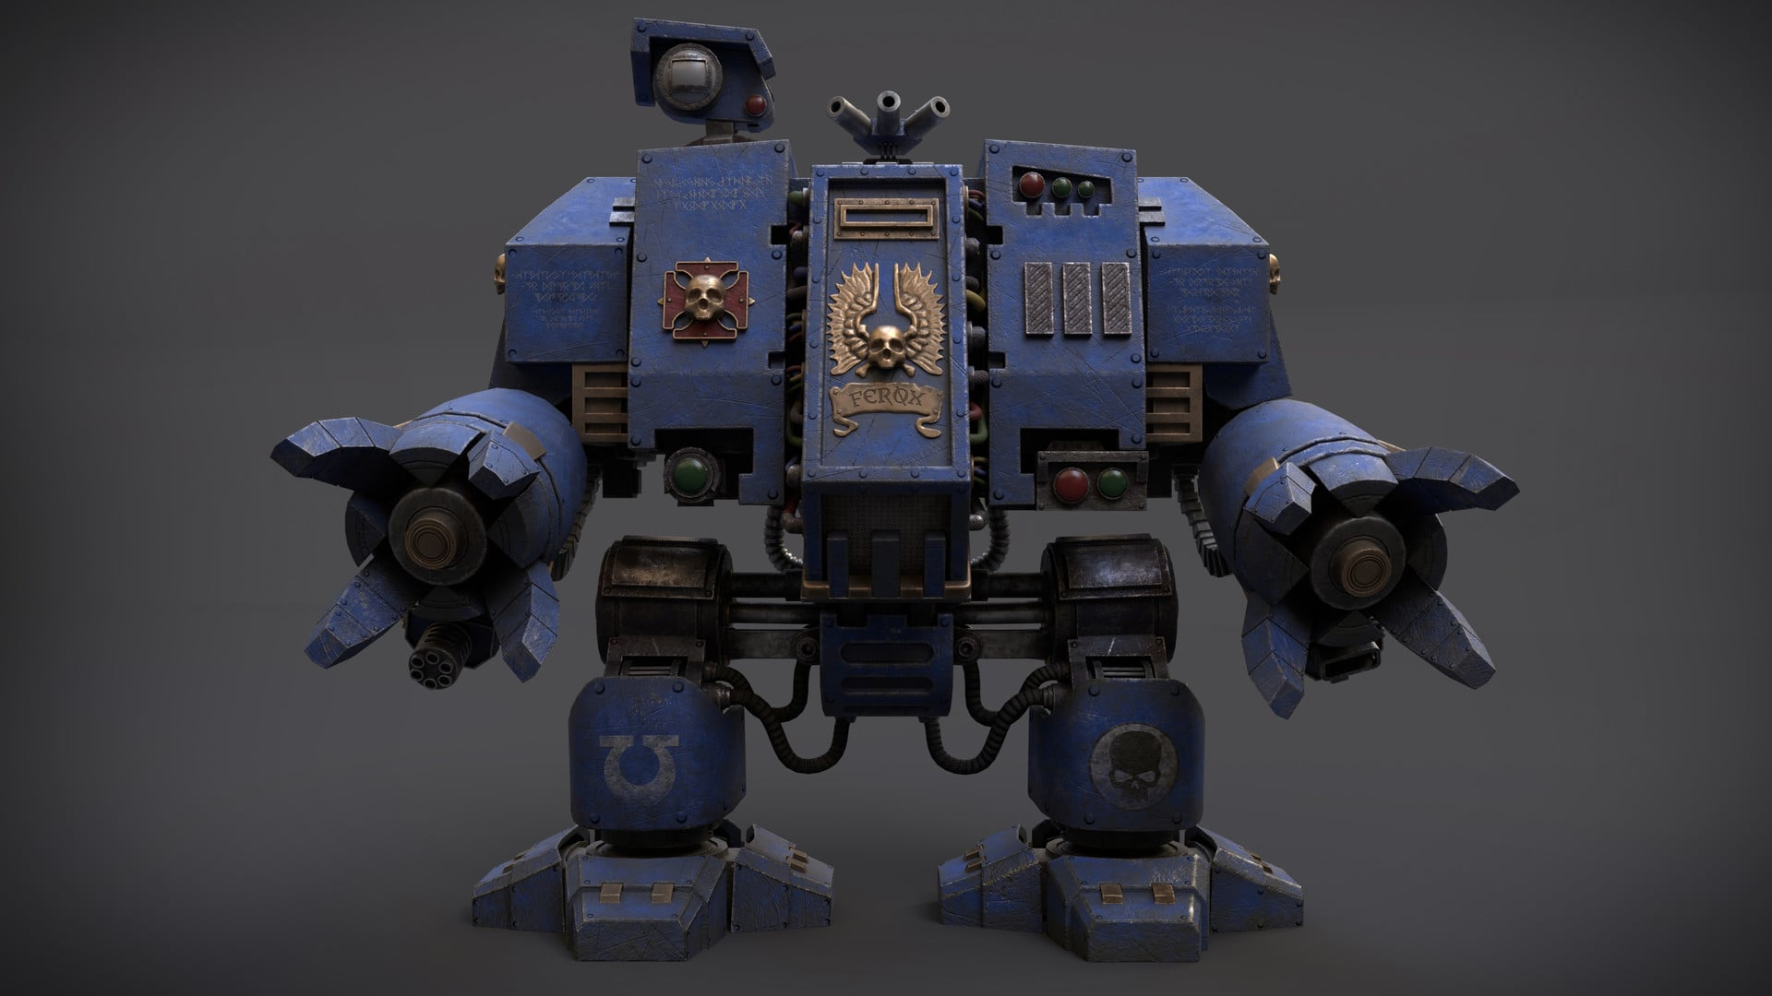
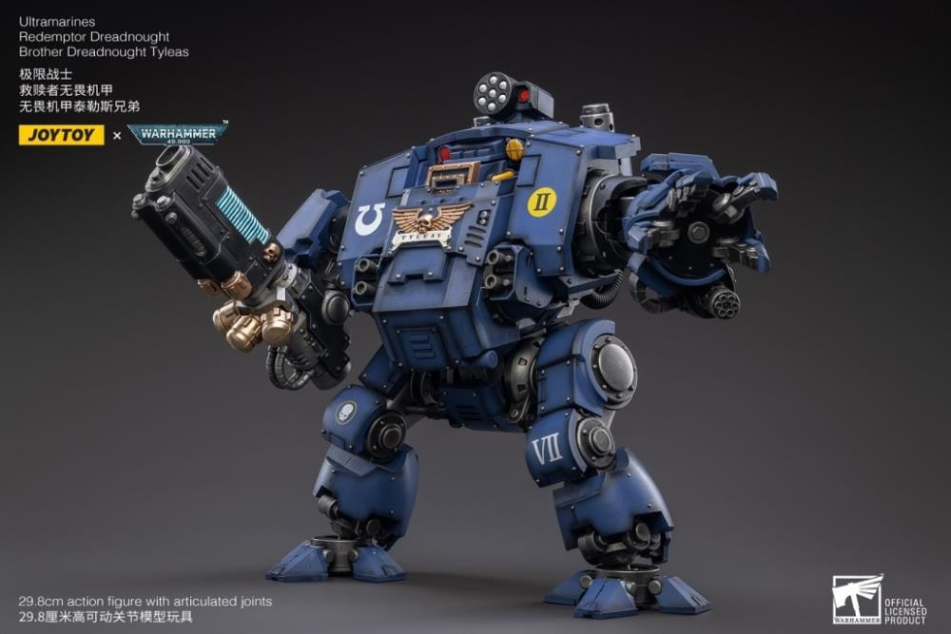
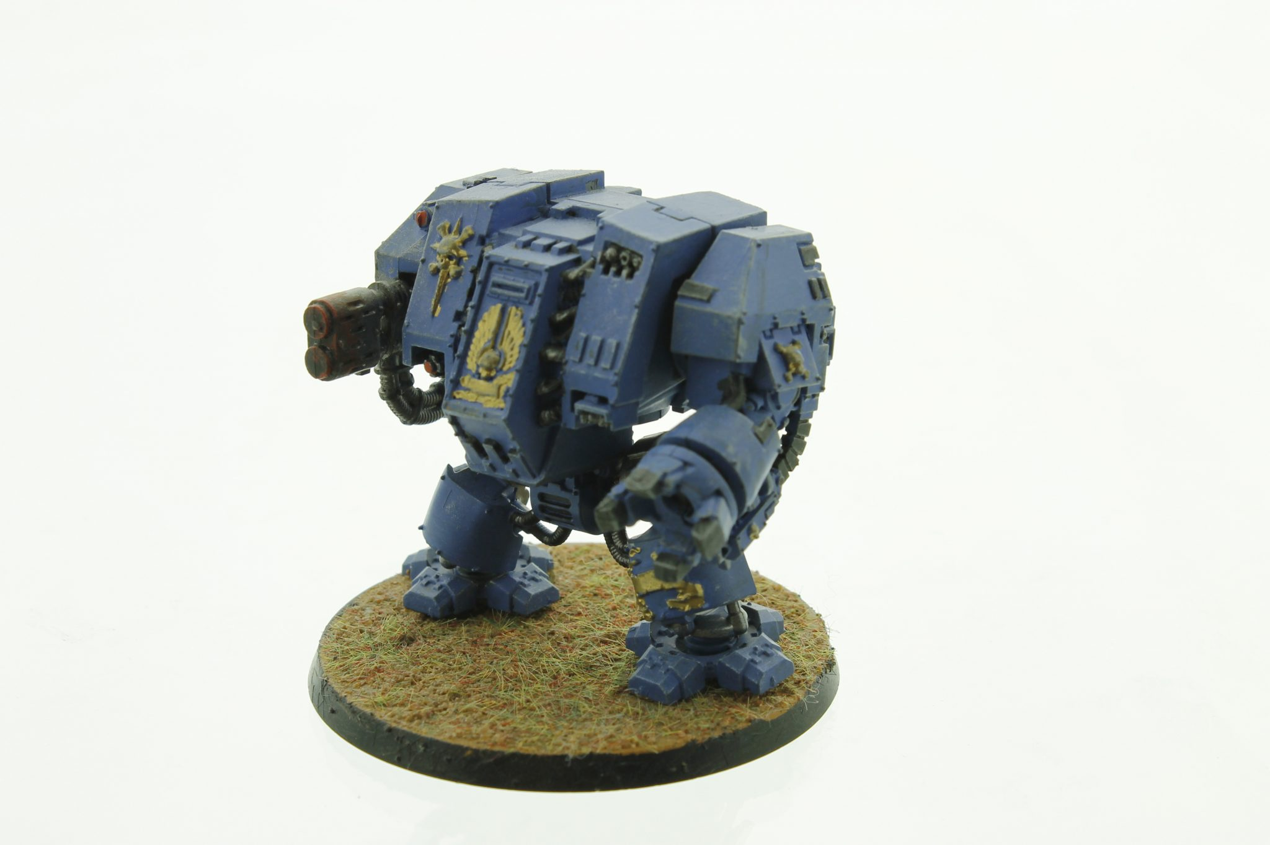
Mech Concept References
GDD
These are some of the modelling references I have gathered to gain a sense of scale and style. Some references don’t link to scale but more to the level of detailing and realism I am aiming for.

Slide 4
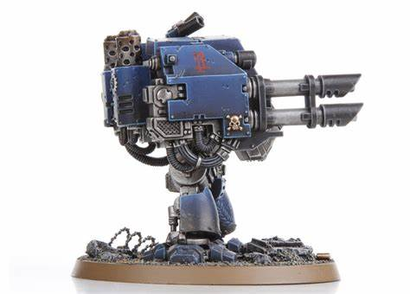
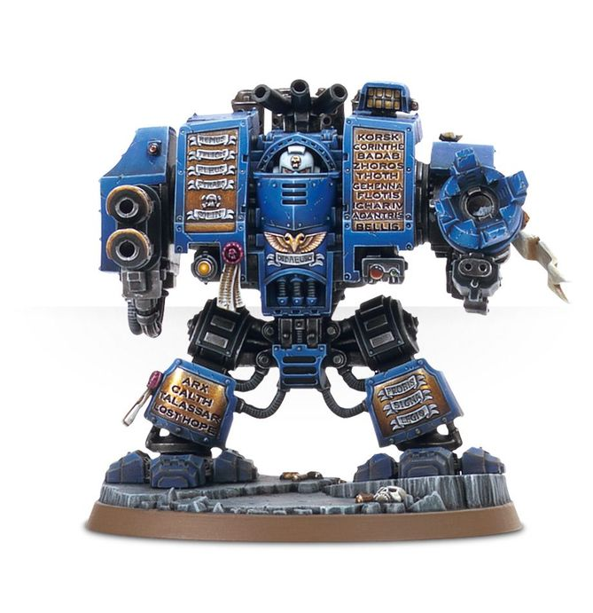
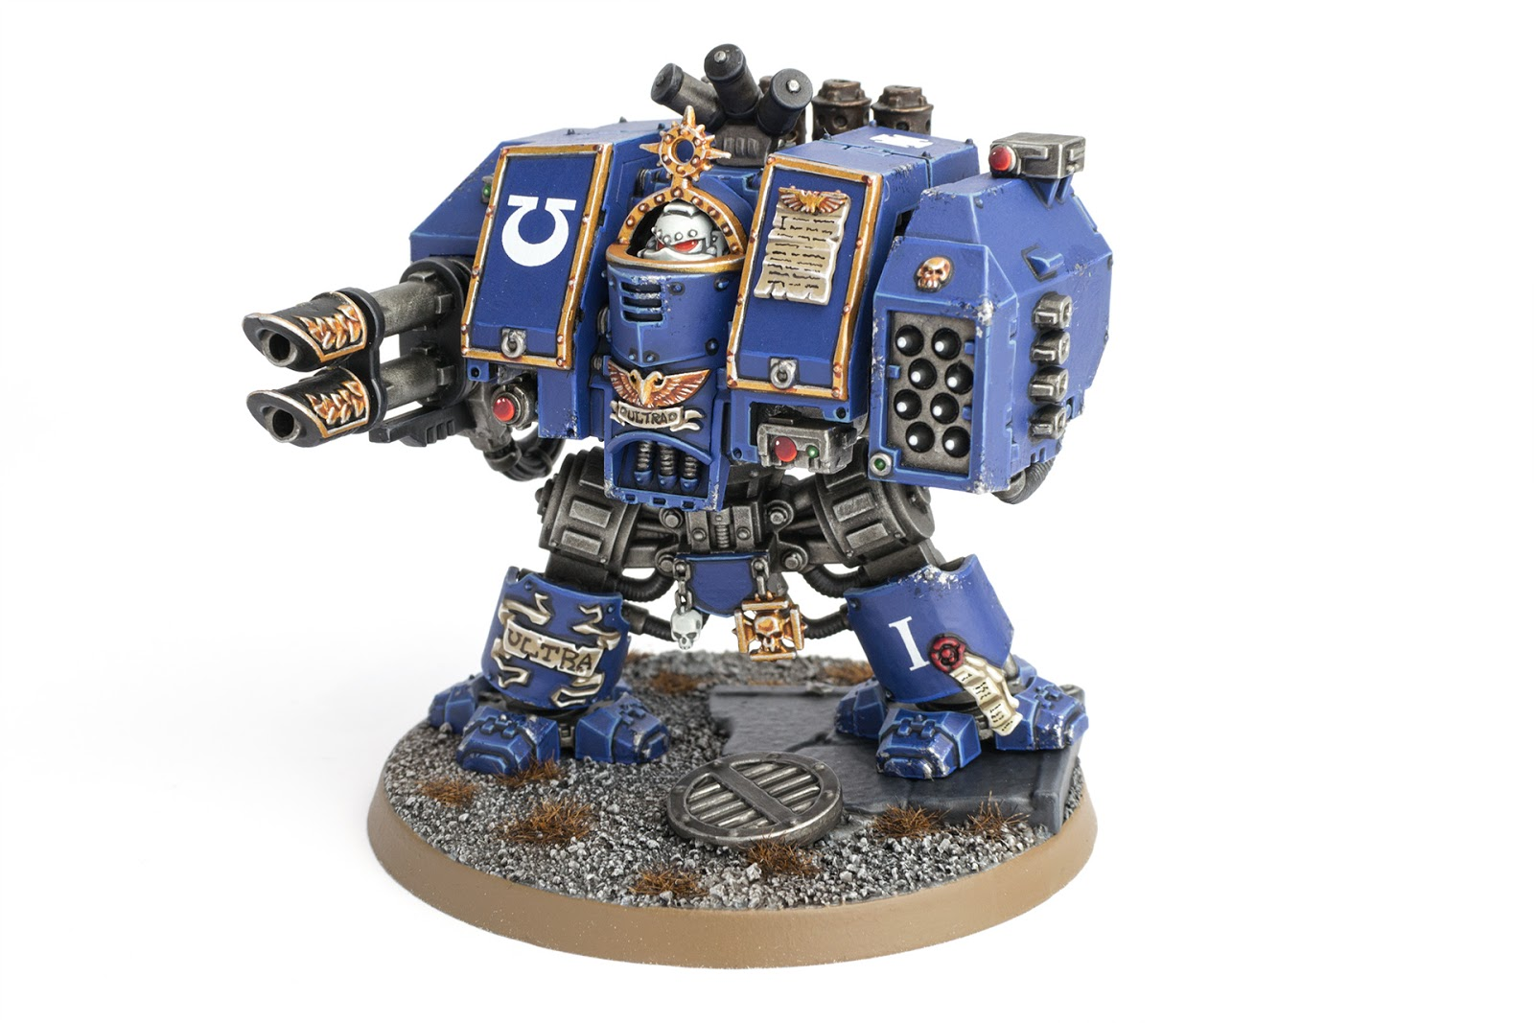
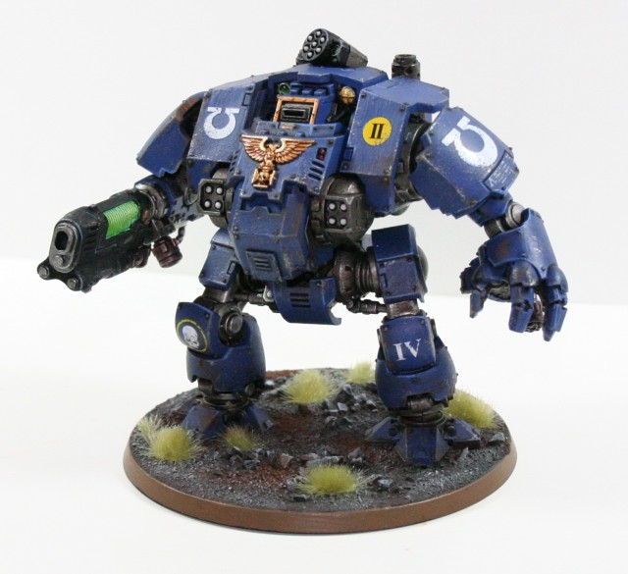
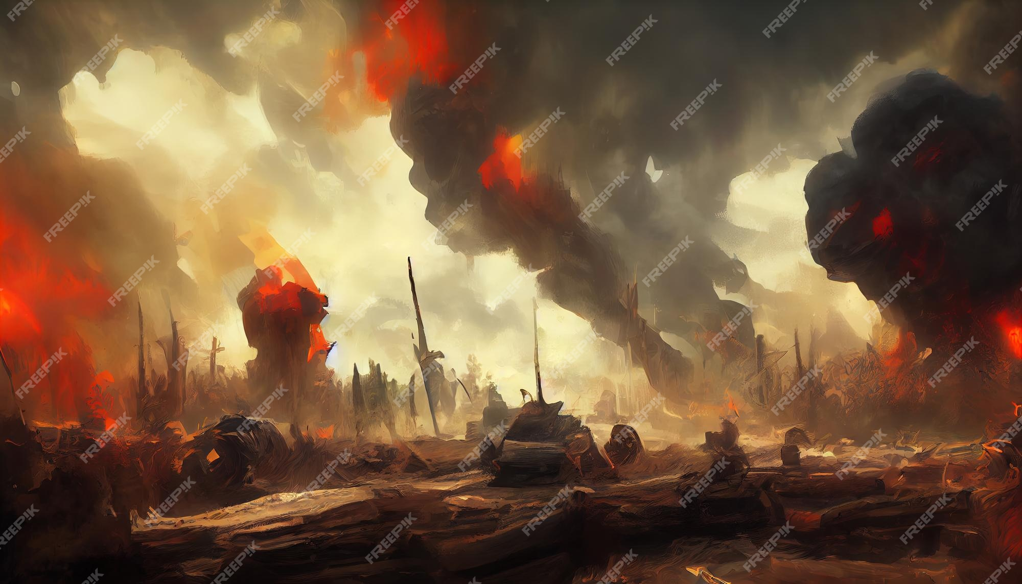
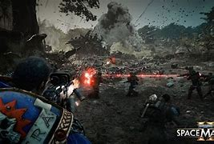
Environment Concept References
GDD
Like the mech references, this too is about finding the scale of objects next to the mech and the style. The stands for the mech are the point of these images

Slide 5
TDD

